Slide 1

Web scraping to gain company insights
19/11/2022

Slide 2
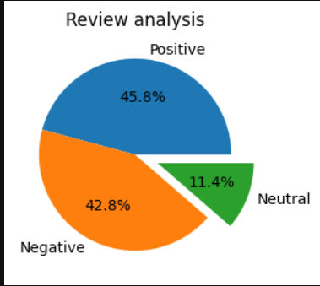
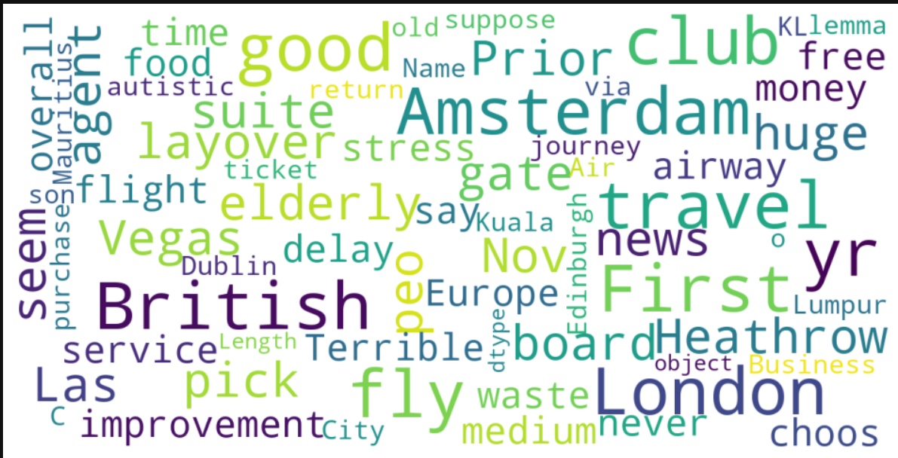
INSIGHTS FROM CUSTOMER REVIEWS
From cleaning 1000 reviews given by the customers, we obtained
Positive Reviews - 458
Negative Reviews - 28
Neutral Reviews – 114
Word cloud of keywords used in reviews

